Slide 1

Breaking Barriers: Bridging the Gender Pay Gap in Biotech
Data-Driven Insights and Solutions
Team Name: Equity Analysts
Notes:
Hello everyone, we are Team 3, comprised of Vish, Nikhil, Bo, Vinith, and me, Tin. Today, we’re here to present our analysis on the gender pay gap in biotech, focusing on equity in compensation and its broader implications for the industry.

Slide 2

Notes:
So, why should we care about this issue? Equity is not about fairness—it’s about fostering innovation, improving patient outcomes, and creating a future where everyone’s contributions are valued equally. Addressing these disparities ensures that talent and ideas thrive, regardless of gender.

Slide 3

Notes:
Let me tell you a story about Dr. Emily, a gifted oncologist at the forefront of cancer research. Over the years, her groundbreaking work has saved countless lives. But when she compared her salary with her male colleagues—doctors with similar experience in the same specialty—she discovered she was earning $110,000 less per year.
At first, Emily thought, “Maybe I just need to negotiate harder.” But then she noticed a pattern. While her male colleagues were offered lucrative consulting gigs and leadership roles, she was frequently assigned unpaid tasks like committee work. This imbalance wasn’t about pay—it was about opportunity.

Slide 4

Notes:
Despite working the same, if not harder, Emily’s lifetime earnings would be $2 million less than her male counterparts. The impact of this disparity extended far beyond her finances—it affected her confidence, her career growth, and even her ability to support her family.
Unfortunately, Emily’s story isn’t unique. It reflects a systemic issue that spans industries, including biotech, where women’s talents and perspectives are often undervalued. And when that happens, we all lose out on the contributions they could have made.

Slide 5

The Challenge
Gender pay disparity in biotech persists.
Male recipients received 67% of total payments in 2023.
High-value categories (e.g., consulting fees) dominate male earnings.
Notes:
Which brings us to the challenges we’ve uncovered through our analysis.

Slide 6

The Dataset
Over 9 million records (2021-2023).
ML-based gender classification with 80-90% accuracy.
Key fields: Payment details, roles, gender, and payment types.
Notes:
We began our research by analyzing three years of general payment datasets from OpenPayments, spanning 2021 to 2023. We focused on the top 20 biotech companies based on revenue and prominence, examining payment details, roles, and how compensation varied by gender.
One challenge we faced was the lack of gender information in the datasets. To address this, we used an open-source gender identification model with high accuracy to supplement the data, enabling a more detailed analysis.

Slide 7

Key Insights – 3-Year Trends
Male recipients dominate consulting fees and faculty/speaker service.
Females saw slight improvement in grants in 2023.
Persistent gaps in acquisitions.
Notes:
Here’s what we found. Over the last three years, men consistently dominated consulting fees and travel reimbursements. There has been some progress in grant payments for women, but the bigger picture remains concerning.
In 2023, male recipients accounted for $800 million—77.03% of total payments—while women received just $250 million, or 22.97%. What’s striking is that the number of male and female recipients is equal: 51.17% male and 48.83% female. This raises an important question: if the recipient numbers are balanced, why is the pay gap so wide? To answer this, we need to look closer at roles and the nature of payments.

Slide 8
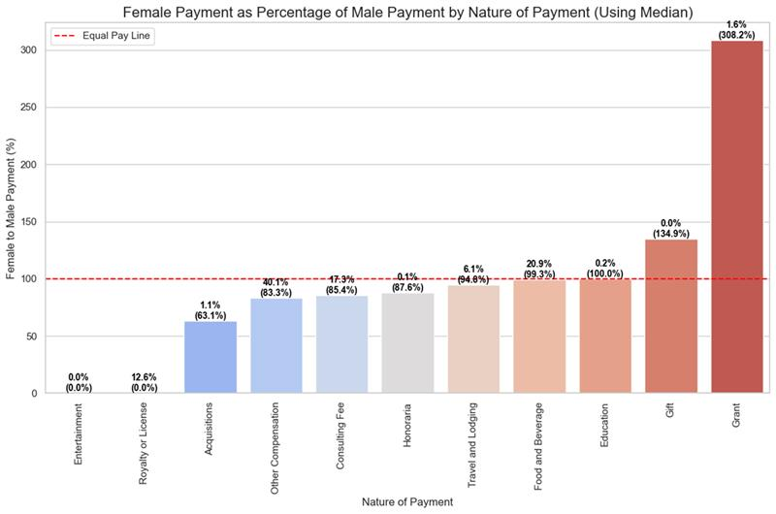

Slide 9

Nature of Payments
Consulting fees: 85% female-to-male median payment ratio.
Zero female recipients for royalties/licenses in 2023.
Notes:
Let’s zoom in on the nature of these payments. Consulting fees are the biggest area of disparity, with women earning just 85.4% of what men make. Now, that might seem like progress compared to other gaps, but let’s not sugarcoat it.
In 2023, women achieved near parity in food and beverage payments—99.3%. But here’s the harsh reality: not a single woman was recorded as a recipient of royalties or licenses. Zero. This isn’t just a gap—it’s a gaping hole, and it underscores why intervention isn’t optional; it’s necessary.

Slide 10
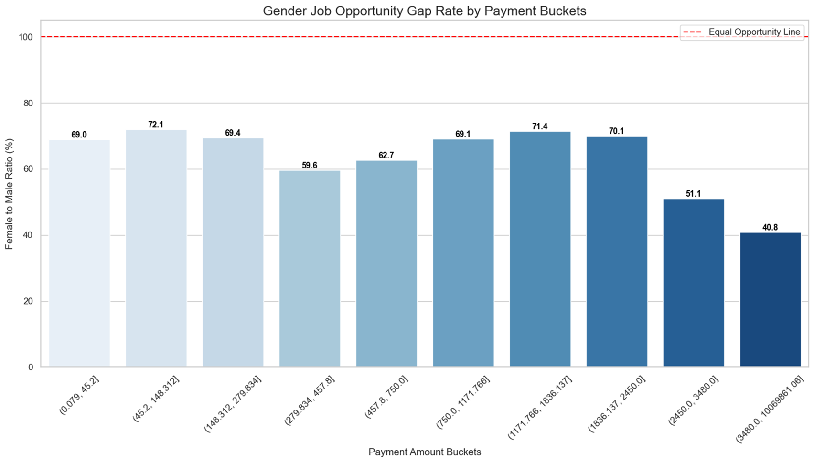

Slide 11

Role-Based Trends
Male-to-female ratio for high-value payments: 41:100.
No female recipients in the top 10 payment records (2023).
Nurse Practitioners show better representation.
Notes:
Let’s talk about roles, where disparities become even more apparent. Male Medical Doctors dominate high-value payments, and this isn’t surprising given that Medical Doctors are the highest-paid roles in our dataset. However, the number of male Medical Doctors is consistently double that of females, which contributes significantly to the pay gap. Women are better represented among Nurse Practitioners, but these roles are not as well-paid as Medical Doctors. This distribution of roles highlights how structural biases perpetuate inequities in compensation.

Slide 12

Company Insights – AbbVie Case Study
Male dominance in consulting fees and travel payments.
Slight improvement for females in grant payments in 2023.
Persistent gaps in roles like Medical Doctors.
Notes:
To dive deeper, we focused on AbbVie, a company consistently ranked for high-value payments among the top 20 we studied. The story here reflects the broader trends: men dominate in consulting fees and travel reimbursements. There have been slight improvements for women in 2023, but the gaps remain glaring—especially between Medical Doctors and Nurse Practitioners.
High-value payments continue to favor men, which reveals a critical need for companies to adopt focused, strategic solutions to close these gaps.

Slide 13

Recommendations
Promote diversity in high-value roles.
Equitable grant distribution.
Annual transparency monitoring.
Recognize equitable companies.
Notes:
So, what can we do about this? Our team proposes three actionable strategies to combat these disparities:
Annual Monitoring: Companies should track progress and identify pay equity issues in real-time to drive immediate improvements.
Recognition Programs: Organizations that achieve equity should be celebrated and incentivized to continue leading by example.
Policy Adjustments: Targeted policies should address gaps, particularly in high-value roles and payments.
These measures go beyond numbers—they aim to create a workplace where everyone can thrive.

Slide 14

Business Impact
Enhanced reputation as an equity leader.
Increased employee retention and satisfaction.
Reduced risk of legal challenges.
Notes:
Here is why this matter: equity is not just ethical—it is strategic. Companies that prioritize fairness benefit from enhanced reputations, greater innovation, and stronger employee morale. They also reduce their risk of legal challenges.
In short, promoting equity is good for employees, good for companies, and essential for shaping a sustainable future.

Slide 15

Conclusion
Gender disparities persist but are not insurmountable.
Recommendations bridge gaps and foster equity.
Call to action: "Let’s make biotech a beacon of progress and inclusivity."
Notes:
In conclusion, while there have been strides in addressing gender pay disparities in biotech, significant gaps remain in consulting fees, acquisitions, and high-value roles.
Our recommendations provide a clear roadmap for fostering equity and driving success—not just for individual companies but for industry. Because when we value everyone equally, we all win.

Slide 16

Thank You
Equity Analysts Team
Notes:
Thank you for your attention. Let’s work together to create a biotech industry where innovation and equity go hand in hand.

